Slide 1
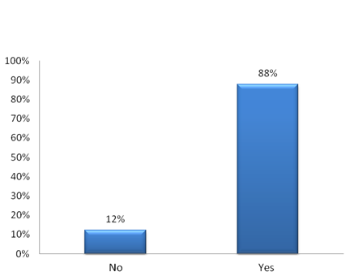
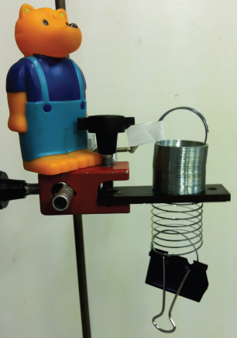
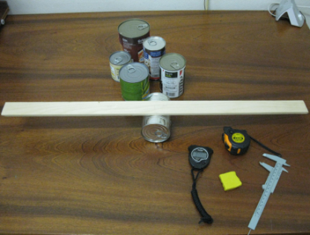
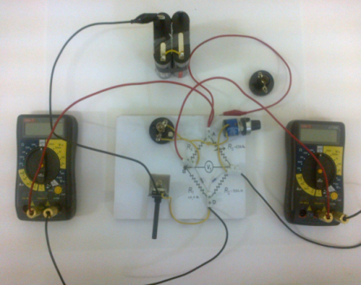
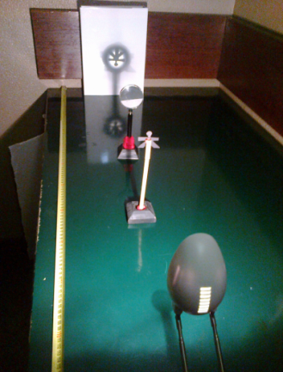
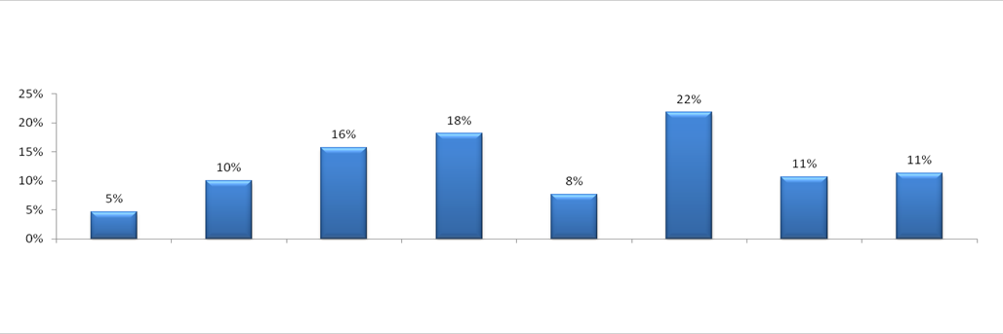
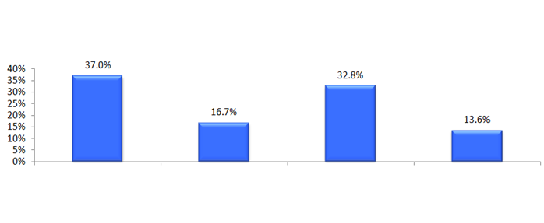
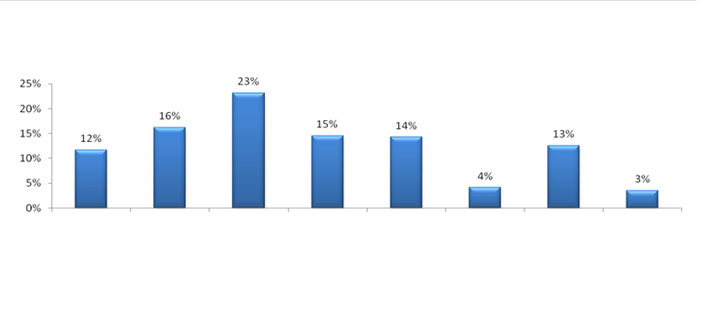


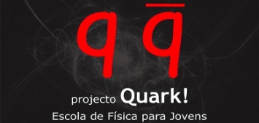
PERFORMANCE OF PORTUGUESE STUDENTS IN PHYSICS OLYMPIADS
Bridging the gap between theory and experiment
F. Oliveira¹ & J.A. Paixão ¹
¹ CEMDRX | Department of Physics | Faculty of Science and Technology | University of Coimbra | Portugal
filipa.oliveira@uc.pt
MOTIVATION
Parts of the METHODOLOGY
Scout for young students with a talent for Physics.
Sample of this study are: olympic students, Quark! school students, high-school students and the accompanying teachers.
Measuring instruments are developed: surveys, interviews and assessment tests.
The experimental activities are being developed based on the conceptual and operational requirements of the International Olympiads.
Teaching resources are prepared with methodological suggestions for teachers.
The experimental activities will also be adapted and tested in several schools.
Develop new teaching resources.
Involve physics teachers in new methodologies.
Stimulate the development of experimental skills.
Identify difficulties and problems in learning and teaching of physics.
Contribute with new proposals for teaching of physics in Portugal.
SOME RESULTS
QUARK! SCHOOL
All graphs correspond to the data collected in the years 2011 and 2012. Missing 2013!
Olympic students began to get better results after attending classes at the Quark! school.
15 – Do you feel the need for specific training in experimental teaching?
All graphs correspond to data collected in the years 2011 and 2012. Missing 2013!
Experimental activities for students and teachers have already been developed: mechanics, electricity, optics, acoustics and thermodynamics.
Regional Offices
301 teachers replied to these two questions.
17 – What are the topics where you face more difficulties when teaching the experimental component?
SOME CONCLUSIONS
Mechanics
Acoustics
Electricity Electronics
Electromagnetism
Thermodynamics
Modern Physics
Radiation
Optics
There are problems:
- teacher training in physics
- official Physics curricula.
Regional Offices
5 – What are the aspects you think are most difficult in the experimental component?
56 students replied to this question.
Schools in Portugal have a reduced number of classes of experimental physics.
Difficultie in using the equipment
The gap between theory and experiment
Understanding of the utterances of the test
Making graphs
The data treatment and the manual dexterity using instruments (e.g. multimeters) were the main difficulties signaled in the experimental activities.
National Offices
15 – What are the main difficulties you encounter while studying physics and chemistry?
Regional Offices
1034 students replied to this question.
REFERENCES… Research study
Problem solving
Interpretation of questions
Understanding of abstract issues
Recognizing if a result is physically meaningful or not
Length of core matter
Mathematics (algebra, trigononometry)
Establishing connections with the real world
Other
Anderson, L. W.; Krathwohl, D. R. et al. (2001). A Taxonomy for Learning, Teaching, and Assessing: A revision of Bloom's Taxonomy of Educational Objectives. New York: Longman.
Serway, R. & Jewett, J. (2010). Physics for Scientists and Engineers with Modern Physics. 8th edition.

